Slide 1
COMP6230: Cybersecurity
Oli Bills
ofb@ecs.soton.ac.uk

Slide 2
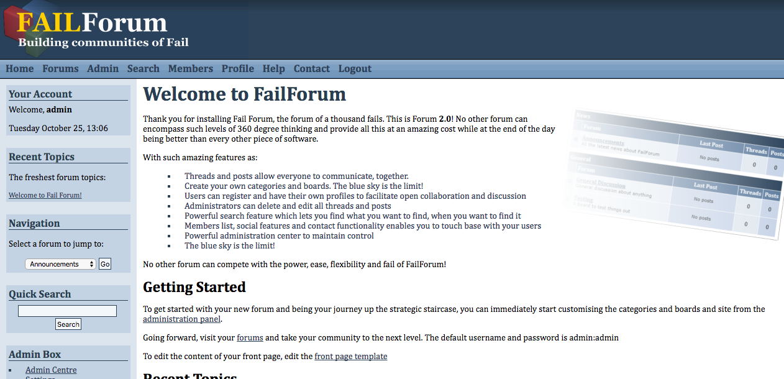
Let’s get interactive
We’re going to hack a forum…

Slide 3
Building our map
Homepage
Forum index
Admin area
Search
Members List
Edit Profile
Help Page
Contact Page
Login
Logout
Resources

Slide 4
Building our map
Homepage
Forum index
View Board
View Thread
New Thread
Admin area
Search
Search Results
Members List
View Member
Edit Profile
Help Page
Contact Page
Login
Logout
Resources
Stylesheet

Slide 5
Building our map
Homepage
Forum index
View Board
View Thread
New Thread
New Reply
Admin area
Search
Search Results
Members List
View Member
Edit Member
Edit Profile
Help Page
Contact Page
Login
Logout
Resources
Stylesheet

Slide 6
Marking our map
Forms [F]
URL parameters [P]
GET parameters [?]
Logic [L]
Members List
View Member
Edit Member
Edit Profile
Help Page
Contact Page
Login
Logout
Resources
Stylesheet
Homepage
Forum index
View Board
View Thread
New Thread
New Reply
Admin area
Search
Search Results
Members List
View Member [?]
Edit Member [?F]
Edit Profile [F]
Help Page
Contact Page [F]
Login [F]
Logout
Resources
Stylesheet [?]
Homepage
Forum index
View Board [?]
View Thread [?]
New Thread [LF?]
New Reply [LF?]
Admin area
Search [?]
Search Results

Slide 7
SQL Injection
Find any user inputs that are linked to the database
Try common injection techniques to determine if any are vulnerable
Can you trigger an error?
Then we know we’re vulnerable
Can you cause any difference in behaviour
Between a valid and invalid query
Error rather than an answer?
A delay?
A different response?
Then, we just need to exploit

Slide 8
SQL Injection: Special Characters
Think about how a query is written
SELECT * FROM users WHERE name=‘???’
Character to try: ‘
But there’s more!
SELECT * FROM posts WHERE title LIKE “%???%”
It’s not an ‘ this time
SELECT * FROM threads ORDER BY `???`

Slide 9
SQL Injection: Special Characters
But even worse, and often forgotten!
SELECT * FROM posts WHERE id=???
You don’t even need a special character here!
Understand the queries you are injecting
What formats
What types
How would it be organised

Slide 10
Using our map
Homepage
Forum index
View Board [?]
View Thread [?]
New Thread [LF?]
New Reply [LF?]
Admin area
Search [?]
Search Results
Members List
View Member [?]
Edit Member [?F]
Edit Profile [F]
Help Page
Contact Page [F]
Login [F]
Logout
Resources
Stylesheet [?]

Slide 11
Using our map: SQL
Homepage
Forum index
View Board [?]
View Thread [?]
New Thread [LF?]
New Reply [LF?]
Admin area
Search [?]
Search Results
Members List
View Member [?]
Edit Member [?F]
Edit Profile [F]
Help Page
Contact Page [F]
Login [F]
Logout
Resources
Stylesheet [?]

Slide 12
Cross-site scripting
Identify any user inputs which are also used in output
Use common XSS code to see if any are vulnerable
Once we’ve identified the vulnerable inputs, exploit them

Slide 13
Using our map
Homepage
Forum index
View Board [?]
View Thread [?]
New Thread [LF?]
New Reply [LF?]
Admin area
Search [?]
Search Results
Members List
View Member [?]
Edit Member [?F]
Edit Profile [F]
Help Page
Contact Page [F]
Login [F]
Logout
Resources
Stylesheet [?]

Slide 14
Using our map: XSS
Homepage
Forum index
View Board [?]
View Thread [?]
New Thread [LF?]
New Reply [LF?]
Admin area
Search [?]
Search Results
Members List
View Member [?]
Edit Member [?F]
Edit Profile [F]
Help Page
Contact Page [F]
Login [F]
Logout
Resources
Stylesheet [?]

Slide 15
Insecure Upload
Identify any areas of the site where the user can upload
Test to the extent to which the uploads are validated or checked
MIME types
File extensions
Content – a valid image?
Embedding what you want in
But you still need it to be effective
Exploit!

Slide 16
Insecure Upload
Filename
Does it change the filename that you give it?
MIME types
The browser sends this – easy!
File extensions
Can you confuse it?
Double extensions
Zip files
Content – a valid image?
Embedding what you want in
EXIF headers
But you still need it to be effective

Slide 17
Using our map
Homepage
Forum index
View Board [?]
View Thread [?]
New Thread [LF?]
New Reply [LF?]
Admin area
Search [?]
Search Results
Members List
View Member [?]
Edit Member [?F]
Edit Profile [F]
Help Page
Contact Page [F]
Login [F]
Logout
Resources
Stylesheet [?]

Slide 18
Using our map: Upload
Homepage
Forum index
View Board [?]
View Thread [?]
New Thread [LF?]
New Reply [LF?]
Admin area
Search [?]
Search Results
Members List
View Member [?]
Edit Member [?F]
Edit Profile [F]
Help Page
Contact Page [F]
Login [F]
Logout
Resources
Stylesheet [?]

Slide 19
Software out of date
Can we identify what software is running?
Can we identify any known vulnerabilities in that software?
Look at the entire response you get
HTTP headers
Meta tags
Comments on the page
Text in the footer
Exploit!

Slide 20
Dangerous files left exposed
Identify common testing files
Identify file structure of the site
Don’t forget temporary files
Version control
Temporary editing files
Use your map combined with searching
Can we find anything that shouldn’t be there?

Slide 21
Dangerous files left exposed
Backup files
Index.php
index.bak
~index.php
index.php~
index.php.bak
.index.php.swp
.index.php.swp~
index.zip
index.php.zip

Slide 22
Dangerous files left exposed
Version control folders
.git
.svn
Metadata files
._filename
.DS_Store
Hidden inside the files itself (e.g. GPS location)
Files not meant for normal people
robots.txt – don’t look here!

Slide 23
Insecure cookies
Look at the cookies from the site
Look at how they work on certain actions
Can they be manipulated?
Exploit!
When are they set?
When are they used?
What data type are they?

Slide 24
Using our map
Homepage
Forum index
View Board [?]
View Thread [?]
New Thread [LF?]
New Reply [LF?]
Admin area
Search [?]
Search Results
Members List
View Member [?]
Edit Member [?F]
Edit Profile [F]
Help Page
Contact Page [F]
Login [F]
Logout
Resources
Stylesheet [?]

Slide 25
Using our map: Cookies
Homepage
Forum index
View Board [?]
View Thread [?]
New Thread [LF?]
New Reply [LF?]
Admin area
Search [?]
Search Results
Members List
View Member [?]
Edit Member [?F]
Edit Profile [F]
Help Page
Contact Page [F]
Login [F]
Logout
Resources
Stylesheet [?]

Slide 26
Insecure Authorisation
Identify administrative actions
Test all stages to see if they’re checking authorisation
Identify how administrative actions might be represented
Any clues?
Look at the framework
Informed attack
Find any gaps in the authorisation
Exploit!

Slide 27
Using our map
Homepage
Forum index
View Board [?]
View Thread [?]
New Thread [LF?]
New Reply [LF?]
Admin area
Search [?]
Search Results
Members List
View Member [?]
Edit Member [?F]
Edit Profile [F]
Help Page
Contact Page [F]
Login [F]
Logout
Resources
Stylesheet [?]

Slide 28
Using our map: Authorisation
Homepage
Forum index
View Board [?]
View Thread [?]
New Thread [LF?]
New Reply [LF?]
Admin area
Search [?]
Search Results
Members List
View Member [?]
Edit Member [?F]
Edit Profile [F]
Help Page
Contact Page [F]
Login [F]
Logout
Resources
Stylesheet [?]

Slide 29
Insecure sessions
What method of sessions are being used?
Are they using the built in session support or their own setup?
Look at how they’re generated and changed
Are they guessable?
Can they be exploited?

Slide 30
Insecure email
Does the site allow the sending of email
How is the email put together?
What input does the user have?
Can anything be modified that shouldn’t be?
Can anything be injected?
Open spam relay!

Slide 31
Using our map
Homepage
Forum index
View Board [?]
View Thread [?]
New Thread [LF?]
New Reply [LF?]
Admin area
Search [?]
Search Results
Members List
View Member [?]
Edit Member [?F]
Edit Profile [F]
Help Page
Contact Page [F]
Login [F]
Logout
Resources
Stylesheet [?]

Slide 32
Using our map: Email
Homepage
Forum index
View Board [?]
View Thread [?]
New Thread [LF?]
New Reply [LF?]
Admin area
Search [?]
Search Results
Members List
View Member [?]
Edit Member [?F]
Edit Profile [F]
Help Page
Contact Page [F]
Login [F]
Logout
Resources
Stylesheet [?]

Slide 33
Brute Force Login
How does the login work?
Is there any protection against brute forcing?
Can I just try all the passwords in the world?
Now we can break into an account!

Slide 34
Using our map
Homepage
Forum index
View Board [?]
View Thread [?]
New Thread [LF?]
New Reply [LF?]
Admin area
Search [?]
Search Results
Members List
View Member [?]
Edit Member [?F]
Edit Profile [F]
Help Page
Contact Page [F]
Login [F]
Logout
Resources
Stylesheet [?]

Slide 35
Using our map: Brute forcing
Homepage
Forum index
View Board [?]
View Thread [?]
New Thread [LF?]
New Reply [LF?]
Admin area
Search [?]
Search Results
Members List
View Member [?]
Edit Member [?F]
Edit Profile [F]
Help Page
Contact Page [F]
Login [F]
Logout
Resources
Stylesheet [?]

Slide 36
Internal Information
What information is given with expected errors?
What information is given with unexpected errors?
Can we cause an unexpected error?
Can we get database errors out of the application?
How does this help us?

Slide 37
Application Logic
What parts of the application use logic
What assumptions are made as part of that logic
How can those assumptions be challenged
This requires you to use your brain!
Automation won’t help you here
Be illogical!

Slide 38
Using our map
Homepage
Forum index
View Board [?]
View Thread [?]
New Thread [LF?]
New Reply [LF?]
Admin area
Search [?]
Search Results
Members List
View Member [?]
Edit Member [?F]
Edit Profile [F]
Help Page
Contact Page [F]
Login [F]
Logout
Resources
Stylesheet [?]

Slide 39
Using our map: Application Logic
Homepage
Forum index
View Board [?]
View Thread [?]
New Thread [LF?]
New Reply [LF?]
Admin area
Search [?]
Search Results
Members List
View Member [?]
Edit Member [?F]
Edit Profile [F]
Help Page
Contact Page [F]
Login [F]
Logout
Resources
Stylesheet [?]

Slide 40
Open Redirects
When an application passes a URL to redirect to another part of the application
The application then sees the passed URL and redirects
Should be restricted to within the site
But often it isn’t validated
Can redirect to malicious sites
It looks like it’s coming from a valid site…
Can you find any redirects with parameters?

Slide 41
File Inclusion
Can we identify any places where files are being read?
Check the URL parameters – the usual culprits
What happens if we request a file that doesn’t exist?
What happens if we request a file that does exist?
Can we break out of the folder and get further?
Dots and slashes are our friends

Slide 42
Using our map
Homepage
Forum index
View Board [?]
View Thread [?]
New Thread [LF?]
New Reply [LF?]
Admin area
Search [?]
Search Results
Members List
View Member [?]
Edit Member [?F]
Edit Profile [F]
Help Page
Contact Page [F]
Login [F]
Logout
Resources
Stylesheet [?]

Slide 43
Using our map: Inclusion
Homepage
Forum index
View Board [?]
View Thread [?]
New Thread [LF?]
New Reply [LF?]
Admin area
Search [?]
Search Results
Members List
View Member [?]
Edit Member [?F]
Edit Profile [F]
Help Page
Contact Page [F]
Login [F]
Logout
Resources
Stylesheet [?]

Slide 44
Exposed interfaces
Sometimes there’s more to an application than the front-end
Is there an API?
Is the API secured?
How does the API work?
What does the API expect?
And what doesn’t it expect…
Is there accessible infrastructure?
Database
AJAX endpoints
Helper scripts/applications

Slide 45
Cross-site request forgery
Are there any GET actions which change the state?
Are there any forms without protection?
How can we exploit these?

